Slide 1
DOM105 2019
Session 1
Reading: SfM Ch.2,3

Slide 2
Categorical and Numerical Data
Categorical data is data that is separated into various groupings or categories for display.
Takes form of tables, bar charts, pie charts, etc.
Numerical data comprises of numbers that have not been separated into categories.
Displays of numerical data include arrays, frequency distributions, scatter plots, etc.
Both types of data can be displayed using some types of tables such as Pivot Tables.

Slide 3
Display Categorical Data – Bar Chart

Slide 4
Pie Chart – Investor’s portfolio
Savings
15%
Stocks
42%
CD 14%
Percentages are rounded to the nearest percent.
Bonds 29%

Slide 5
Side by side Bar Chart
Uses sets of bars to show joint responses from two or more categorical variables.

Slide 6
Tabulating Numerical Data: Frequency Distributions
Sort raw data in ascending order: 12, 13, 17, 21, 24, 24, 26, 27, 27, 30, 32, 35, 37, 38, 41, 43, 44, 46, 53, 58
Find range: 58 - 12 = 46
Select number of classes: 5 (usually between 5 and 15)
Compute class interval (width): 10 (46/5 then round up)
Determine class boundaries (limits): 10, 20, 30, 40, 50, 60
Compute class midpoints: 15, 25, 35, 45, 55
Count observations & assign to classes

Slide 7
Frequency Distributions, Relative Frequency Distributions and Percentage Distributions
Data in ordered array:
12, 13, 17, 21, 24, 24, 26, 27, 27, 30, 32, 35, 37, 38, 41, 43, 44, 46, 53, 58
Relative
Frequency
Percentage
Class Frequency
10 but under 20 3 .15 15
20 but under 30 6 .30 30
30 but under 40 5 .25 25
40 but under 50 4 .20 20
50 but under 60 2 .10 10
Total 20 1 100

Slide 8
Graphing Numerical Data: The Histogram
Data in ordered array:
12, 13, 17, 21, 24, 24, 26, 27, 27, 30, 32, 35, 37, 38, 41, 43, 44, 46, 53, 58
No Gaps Between Bars
Class Boundaries
Class Midpoints

Slide 9
Tabulating Numerical Data: Cumulative Frequency
Data in ordered array:
12, 13, 17, 21, 24, 24, 26, 27, 27, 30, 32, 35, 37, 38, 41, 43, 44, 46, 53, 58
Cumulative Cumulative
Class Frequency % Frequency
10 but under 20 3 15
20 but under 30 9 45
30 but under 40 14 70
40 but under 50 18 90
50 but under 60 20 100

Slide 10
Graphing Numerical Data: The Ogive (Cumulative % Polygon)
Data in ordered array:
12, 13, 17, 21, 24, 24, 26, 27, 27, 30, 32, 35, 37, 38, 41, 43, 44, 46, 53, 58
Class Boundaries (Not Midpoints)

Slide 11
Graphing Two Numerical Variables - Scatter Plot

Slide 12
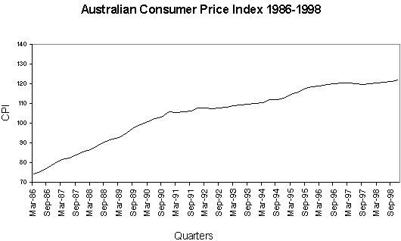
Time-Series Plot
Numerical variable on Y-axis, associated time period on X-axis.

Slide 13
Errors in visualizing data
Using “chart junk”, visual effects that distort or distract from the data to be presented, eg: garish graphics, irrelevant visuals.
Failing to provide a relative basis in comparing data between groups. For example, two separate pie charts showing the operations of two companies does not help if we’re trying to compare the two.
Compressing the vertical axis – using an axis going up to 100 when the highest value is 30.
Make sure to include zero on the axes.

Slide 14
Measures of Central Tendency
Most sets of data show a tendency to group around a central value, this is the ‘central tendency’.
The most common measures of central tendency are mean, median, and mode.
The mean, also called the arithmetic mean, is the average of all values in the sample space.
n is the size of the sample.

Slide 15

Arithmetic Mean of Grouped Data
d is the number of classes
f_{i} is the frequency of the i^{th} class
x_{i} is the mid-point of the i^{th} class
n is the sample size

Slide 16
Grouped data mean example
Data: 12, 13, 17, 21, 24, 24, 26, 27, 27, 30, 32, 35, 37, 38, 41, 43, 44, 46, 53, 58
Mean = (15*3+25*6+35*5+45*4+55*2)/20 = 33
Relative
Frequency
Percentage
Class Frequency
10 but under 20 3 .15 15
20 but under 30 6 .30 30
30 but under 40 5 .25 25
40 but under 50 4 .20 20
50 but under 60 2 .10 10
Total 20 1 100

Slide 17
Median
Robust measure of central tendency
Not affected by extreme values
In an ordered array, the median is the “middle” number
Median: (n+1)/2 ranked value.
If n is odd, the median is the middle number.
If n is even, the median is the average of the two middle numbers.

Slide 18

Calculating Median of Grouped data
Use cumulative frequency to find class that contains median.
n is sample size, w is class interval width
F is cumulative frequency up to but not including the median class.
f_{m} is the frequency of the median class
L_{m} is the lower limit of the median class.
Example: [((20+1)/2 – (9+1))/5]*10 + 30 = 31
The median formula can be modified to calculate any percentile. Eg, for 90th percentile change (n+1)/2 to (n+1)(9/10) and change fm, F, Lm, and w accordingly.

Slide 19
Mode
A measure of central tendency
It is the value that occurs most often in the sample.
Not affected by extreme values
Used for either numerical or categorical data
There may be no mode if all values have the same frequency
There may be several modes if more than one value are tied for the highest frequency.

Slide 20

Calculating mode of grouped data
Determine the class with the highest frequency. This is called the modal class.
L_{M0} is the lower limit of the modal class.
d₁ is the difference between modal class frequency and the frequency of the class with value below the modal class.
d₂ is the difference between modal class frequency and the frequency of the class with value above the modal class.
w is the width of the modal class interval.
In the example, mode = 20+((6-3)/(6-3+6-5))*10=27.5

Slide 21
Example
20 to less than 32 6
32 to less than 44 8
44 to less than 56 12
56 to less than 68 5
68 to less than 80 3
n=6+8+12+5+3=34
Mean = (26*6 + 38*8 + 12*50 + 5*62 + 3*74)/34
Median = (34+1)*0.5 = 17.5th data point, F=6+8=14,
44+ [(17.5-15)/12]*12=46.5
Mode: Lower limit: 44, d1=4, d2=7
Mode = 44+ [4/(4+7)]*12=48.44

Slide 22
Variation and shape of data: Range
Measure of variation
Difference between the largest and the smallest observations:
Ignores the way in which data are distributed
Does not consider how the values cluster between extremes.

Slide 23

Variance
Important measure of variation
Shows variation about the mean
Is the average of the square of the difference between an element and the mean
Sample variance: , $\overline{X}$ is the sample mean.
Population variance: , µ is the population mean.

Slide 24
Standard Deviation
Most important measure of variation
Shows variation about the mean
Has the same units as the original data
Is the square root of the variance
Sample standard deviation:
Population standard deviation:

Slide 25
Why do we divide by (n-1) for sample variance?
For a sample variance to be unbiased, the average variance for all possible samples for a given population has to be equal to the population variance.
It was mathematically shown that if the sample variance was calculated using n instead of n-1, the average variance of all possible samples was not equal to population variance.
This is called Bessel’s correction.
Only used when the population mean and variance is unknown.

Slide 26
Shape of a Distribution
Describes how data is distributed
Measures of shape
Symmetric or skewed
Left-skewed or negative
Symmetric
Right-skewed or positive
Mean < Median < Mode
Mean = Median =Mode
Mode < Median < Mean

Slide 27
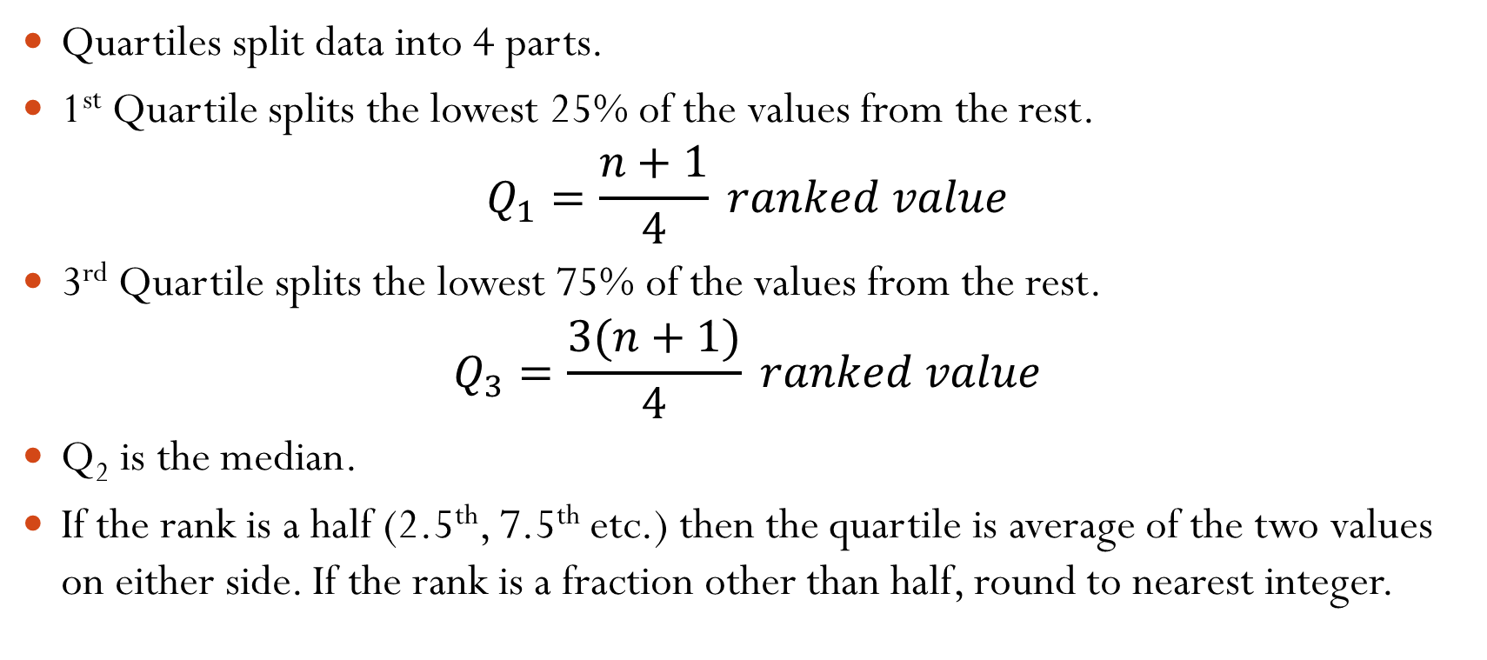
Quartiles
Quartiles split data into 4 parts.
1st Quartile splits the lowest 25% of the values from the rest.
$$Q_{1}=\frac{n+1}{4} ranked value$$
3rd Quartile splits the lowest 75% of the values from the rest.
$$Q_{3}=\frac{3(n+1)}{4} ranked value$$
Q₂ is the median.
If the rank is a half (2.5th, 7.5th etc.) then the quartile is average of the two values on either side. If the rank is a fraction other than half, round to nearest integer.

Slide 28
Interquartile Range
Measure of variation
Also known as midspread
Spread in the middle 50%
Difference between the first and third quartiles
Not affected by extreme values
Data in Ordered Array: 11 12 13 16 16 17 17 18 21

Slide 29
Pitfalls and Ethical Considerations
Data analysis is objective
Should report the summary measures that best meet the assumptions about the data set
Data interpretation is subjective
Should be done in fair, neutral and clear manner
Numerical descriptive measures:
Should document both good and bad results
Should be presented in a fair, objective and neutral manner
Should not use inappropriate summary measures to distort facts

